Slide 1
DRONE MISSION PLANNING SOFTWARE
Taylor Trabun David Klingenberg
Emeth Thompson Joe Higley
University of Idaho – Moscow, ID

Slide 2
Overview
Problem Definition
Project Status
Goals & Plans
Hardware
Communications
GUI
Demo
Q & A

Slide 3
Problem Definition
The goal of this project is to design and develop a graphical user interface (GUI) for drone mission planning.
Requirements:
User friendly interface
Allow 3D mission planning
Upload the flight plan using XAPI and Xbee
Allow Manual Override during flight
Implement Drone Hardware for flight control

Slide 4
Project Deliverables
Alpha version of Graphical User Interface (GUI)
Integrated prototype instrument panel into GUI (Code by Guillaume CHOUTEAU )
Arduino firmware for home and drone with xapi and drone services
Basic communications integrated with drone and GUI
Fully configured drone hardware
Initial drone prototype firmware

Slide 5
hardware

Slide 6
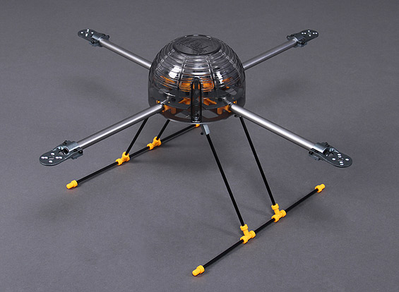
hardware

Slide 7
Firmware
Arduino firmware uses xapi to manage services that control different aspects of communication
Home firmware for Arduino connected to Windows PC running mission control software
relays packets, over a serial connection, to the Arduino then over xBee modules to drone Arduino
Drone firmware for driving flight computer
Enables automatic or manual control
Auto pilot manipulation via xapi services we developed

Slide 8
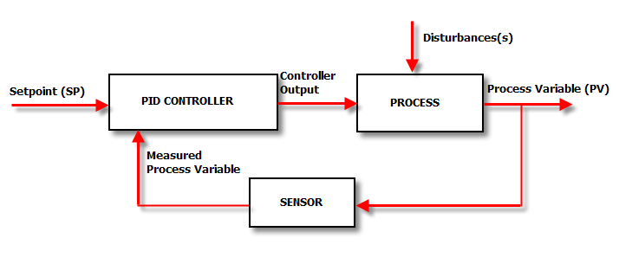
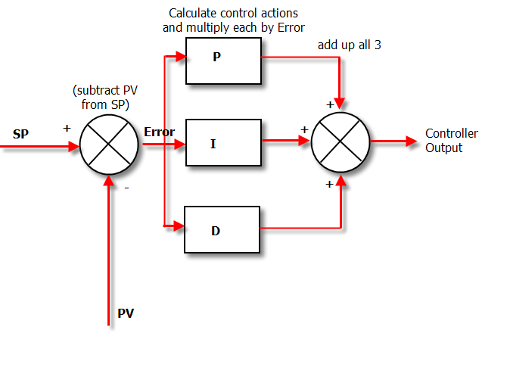
Firmware

Slide 9
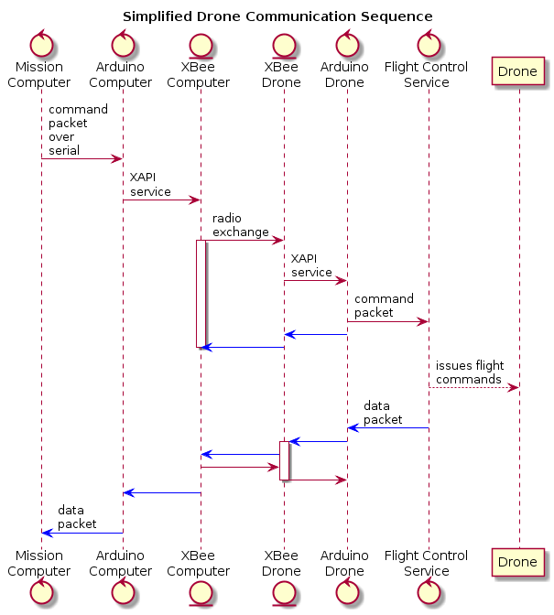
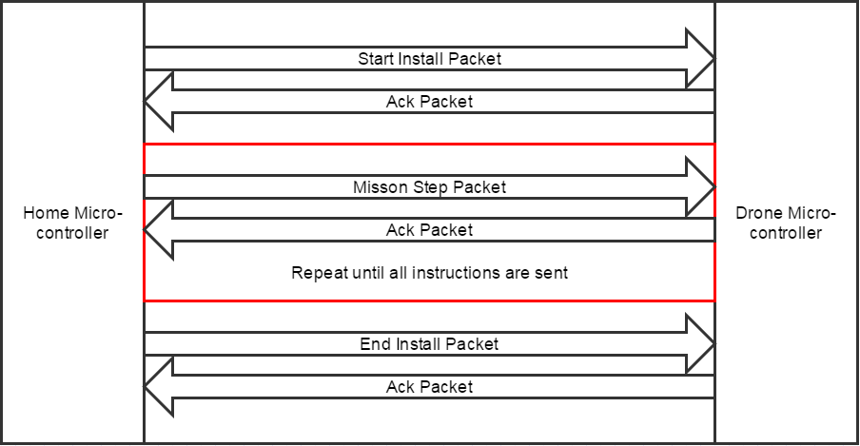
Communication Designs

Slide 10
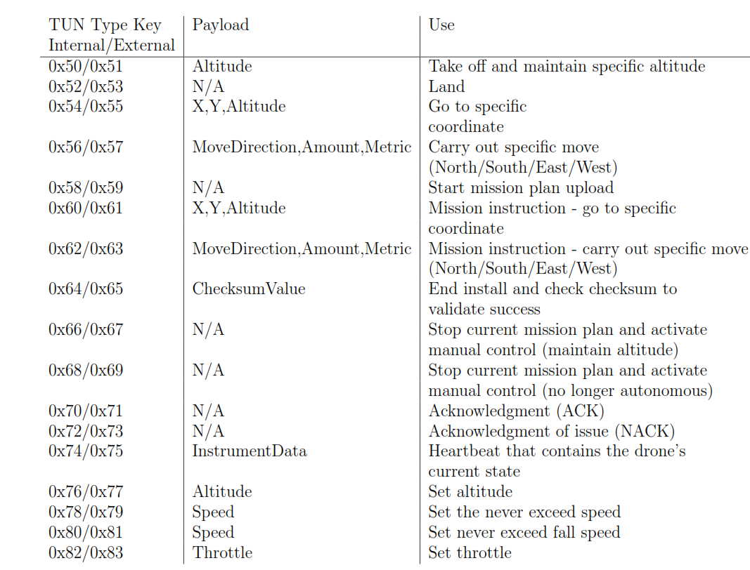
Communication Packet Types

Slide 11
Mission Control Software
goals
have topographical data available for mission planning
Real time controls
Emergency land button
Pause mission and hover button

Slide 12
Mission Control Software
Goals
Instrument Panel – provides real time information about drone in flight
Artificial horizon
Vertical speed indicator
Dial compass
Two minute turn coordinator

Slide 13
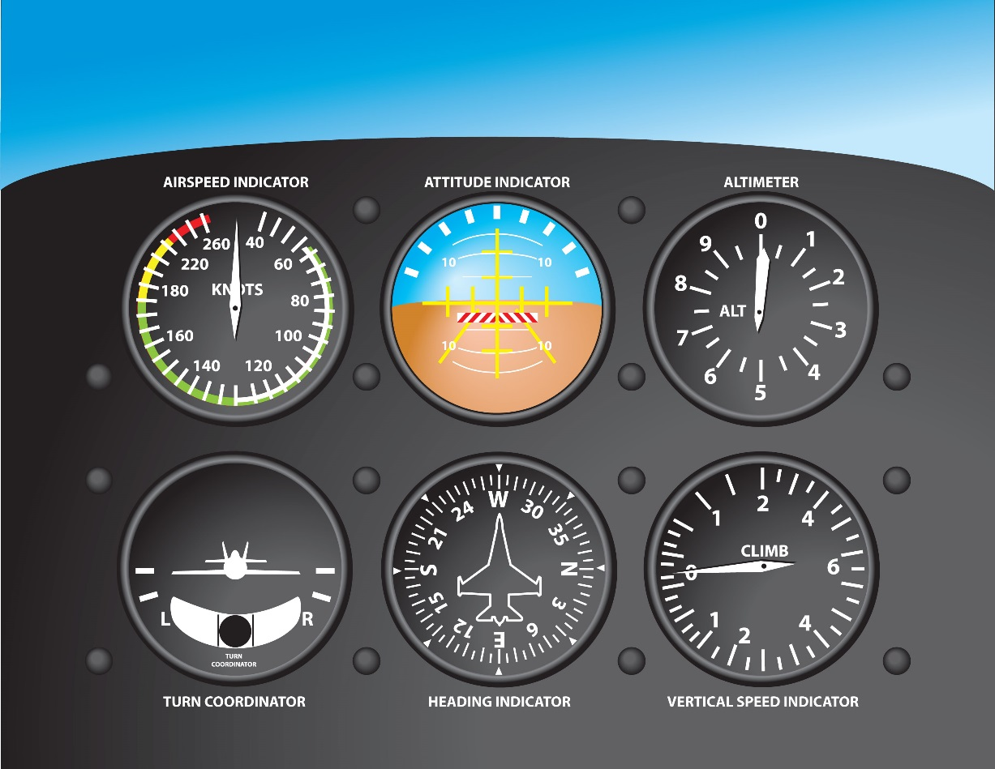
Mission Control Software
Instrument Panel

Slide 14
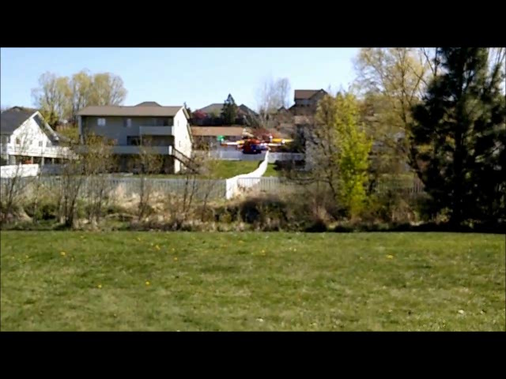
Testing (auto Pilot)

Slide 15
Thank you Questions?

